Slide 1
Spacex Presentation on Capstone IBM Data Science
Samuel Breen

Slide 2
Presentation Contents
P3 Executive Summary and Data Methodology
P4 Introduction
P5 API Data Collection
P6 web scraping
P7 Data Wrangling
P8 EDA with Visualization
P9 EDA with SQL
P10 Interactive Maps with Folium
P11 Plotly Dash Dashboard
P12 Predictive Analytics with Machine Learning
P13 Results
p14

Slide 3

Executive summary and Data Methodology
The methods used in this project were
1. API Collection
2. Data Wrangling
3 Web Scraping
4.Explortory Data Analysis
5. Exploratory Data Analysis with visualisation
7 Ploty Dash
6. Predictive Analysis with Machine Learning
In this project on Space x , it was studies from various aspects , such as location of site, failure and success rates of landing , map visualisation relating to said site maps.
The Data was analysed through various methods.
These will be discussed in each section and given detail on each aspect of data analysis from each method.
I will explain each method type and then go into detail how each affected SpaceX.

Slide 4
Introduction
In this project on Space x , it was studies from various aspects , such as location of site, failure and success rates of landing , map visualisation relating to said site maps.
The Data was analysed through various methods.
These will be discussed in each section and given detail on each aspect of data analysis from each method.
I will explain each method type and then go into detail how each affected SpaceX.
SpaceX, a leader in the space industry, strives to make space travel affordable for everyone. Its accomplishments include sending spacecraft to the international space station, launching a satellite constellation that provides internet access and sending manned missions to space. SpaceX can do this because the rocket launches are relatively inexpensive ($62 million per launch) due to its novel reuse of the first stage of its Falcon 9 rocket. Other providers, which are not able to reuse the first stage, cost upwards of $165 million each. By determining if the first stage will land, we can determine the price of the launch. To do this, we can use public data and machine learning models to predict whether SpaceX –or a competing company –can reuse the first stage.

Slide 5
API Data Collection
Steps
Requestdata from SpaceX API (rocket launch data)
Decoderesponse using .json() and convert to a dataframeusing .json_normalize()
Request informationabout the launches from SpaceX API using custom functions
Create dictionaryfrom the data
Create dataframefrom the dictionary
Filter dataframe to contain only Falcon 9 launches
Replace missing values of Payload Mass with calculated .mean()
Export data to csv file

Slide 6
Web Scraping
Steps
Request data(Falcon 9 launch data) from Wikipedia
Create BeautifulSoupobject from HTML response
Extract column names from HTML table header
Collect data from parsing HTML tables
Create dictionary from the data
Create dataframe from the dictionary
Export data to csv file

Slide 7
Data Wrangling
Steps
Perform EDA and determine data labels
Calculate:# of launches for each site
# and occurrence of orbit
# and occurrence of mission outcome per orbit type]
Create binary landing outcome column (dependent variable)
Export data to csv file
False Ocean:represented an unsuccessful landing to a specific region of ocean
True RTLS:meant the mission had a successful landing on a ground pad
False RTLS: represented an unsuccessful landing on a ground pad
True ASDS: meant the mission outcome had a successful landing on a drone ship
False ASDS: represented an unsuccessful landing on drone ship
Outcomes converted into 1 for a successful landing and 0 for an unsuccessful landing
Landing Outcome Cont.
Landing Outcome
Landing was not always successful
True Ocean :mission outcome had a successful landing to a specific region of the ocean

Slide 8
Exploratory Data Analysis
Charts
Flight Number vs. Payload
Flight Number vs. Launch Site
Payload Mass (kg) vs. Launch Site
Payload Mass (kg) vs. Orbit type
EDA with Visualization
Analysis
View relationship by using scatter plots. The variables could be useful for machine learning if a relationship exists
Show comparisons among discrete categories with bar charts. Bar charts show the relationships among the categories and a measured value.

Slide 9

EDA with SQL
Queries
Display:
Names of unique launch sites
5 records where launch site begins with ‘CCA’
Total payload mass carried by boosters launched by NASA (CRS)
Average payload mass carried by booster version F9 v1.1.
List:
Date of first successful landing on ground pad
Names of boosters which had success landing on drone ship and have payload mass greater than 4,000 but less than 6,000
Total number of successful and failed missions
Names of booster versions which have carried the max payload
Failed landing outcomes on drone ship, their booster version and launch site for the months in the year 2015

Slide 10
Interactive Maps with Folium
Markers Indicating Launch Sites
Added blue circle at NASA Johnson Space Centre's coordinate with a popup label showing its name using its latitude and longitude coordinates
Added red circles at all launch sites coordinates with a popup label showing its name using its name using its latitude and longitude coordinates
Map with Folium
Colored Markers of Launch Outcomes
Added coloured markers of successful(green) and unsuccessful(red) launches at each launch site to show which launch sites have high success rates
Distances Between a Launch Site to Proximities
Added coloured lines to show distance between launch site CCAFS SLC-40 and its proximity to the nearest coastline, railway, highway, and city

Slide 11
Plotly Dash Dashboard
Dropdown List with Launch Sites
Allow user to select all launch sites or a certain launch site
Dashboard with Plotly Dash
Slider of Payload Mass Range
Allow user to select payload mass range
Pie Chart Showing Successful Launches
Allow user to see successful and unsuccessful launches as a percent of the total
Scatter Chart Showing Payload Mass vs. Success Rate by Booster Version
Allow user to see the correlation between Payload and Launch Success

Slide 12
Predictive Analytics with Machine Learning
Charts
Create NumPy array from the Class column
Standardize the data with StandardScaler. Fit and transform the data.
Split the data using train_test_split
Create a GridSearchCV object with cv=10 for parameter optimization
Apply GridSearchCV on different algorithms: logistic regression (LogisticRegression()), support vector machine (SVC()), decision tree (DecisionTreeClassifier()), K-Nearest Neighbor (KNeighborsClassifier())
Calculate accuracy on the test data using .score() for all models
Assess the confusion matrix for all models
Identify the best model using Jaccard_Score, F1_Score and Accuracy

Slide 13
Results Exploratory Data Analysis
Launch success has improved over time
KSC LC-39A has the highest success rate among landing sites
Orbits ES-L1, GEO, HEO and SSO have a 100% success rate
Results Summary
Visual Analytics
Most launch sites are near the equator, and all are close to the coast
Launch sites are far enough away from anything a failed launch can damage (city, highway, railway), while still close enough to bring people and material to support launch activities
Predictive Analytics
Decision Tree model is the best predictive model for the dataset

Slide 14
Flight Number vs. Launch Site
Exploratory Data Analysis
Earlier flights had a lower success rate (blue = fail)
Later flights had a higher success rate (orange = success)
Around half of launches were from CCAFS SLC 40 launch site
VAFB SLC 4E and KSC LC 39A have higher success rates
We can infer that new launches have a higher success rate

Slide 15
Payload vs. Launch Site
Exploratory Data Analysis
Typically, the higherthe payload mass (kg), the higher the success rate
Most launces with a payload greater than 7,000 kg were successful
KSC LC 39A has a 100% success rate for launches less than 5,500 kg
VAFB SKC 4E has not launched anything greater than ~10,000 kg

Slide 16
Success Rate by Orbit
Exploratory Data Analysis
100% Success Rate: ES-L1, GEO, HEO and SSO
50%-80% Success Rate: GTO, ISS, LEO, MEO, PO
0% Success Rate: SO

Slide 17
Flight Number vs. Orbit
Exploratory Data Analysis
The success rate typically increases with the number of flights for each orbit
This relationship is highly apparent for the LEO orbit
The GTO orbit, however, does not follow this trend

Slide 18
Payload vs. Orbit
Exploratory Data Analysis
Heavy payloads are better with LEO, ISS and PO orbits
The GTO orbit has mixed success with heavier payloads

Slide 19
Launch Success over Time
Exploratory Data Analysis
The success rate improved from 2013-2017 and 2018-2019
The success rate decreased from 2017-2018 and from 2019-2020
Overall, the success rate has improved since 2013

Slide 20
Launch Site Information
Launch Site Names
CCAFS LC-40
CCAFS SLC-40
KSC LC-39A
VAFB SLC-4E
Landing Outcome Cont.
Records with Launch Site Starting with CCA
Displaying 5 records below

Slide 21
Payload Mass
Total Payload Mass
45,596 kg (total) carried by boosters launched by NASA (CRS)
2,928 kg (average) carried by booster version F9 v1.1
Average Payload Mass
2,928 kg (average) carried by booster version F9 v1.1

Slide 22
Landing & Mission Info
1stSuccessful Landing in Ground Pad
12/22/2015
Booster Drone Ship Landing
Booster mass greater than 4,000 but less than 6,000
JSCAT-14, JSCAT-16, SES-10, SES-11 / EchoStar 105
Total Number of Successful and Failed Mission Outcomes
1 Failure in Flight
99 Success
1 Success (payload status unclear)

Slide 23
Boosters
Carrying Max Payload
F9 B5 B1048.4
F9 B5 B1049.4
F9 B5 B1051.3
F9 B5 B1056.4
F9 B5 B1048.5
F9 B5 B1051.4
F9 B5 B1049.5
F9 B5 B1060.2
F9 B5 B1058.3
F9 B5 B1051.6
F9 B5 B1060.3
F9 B5 B1049.7

Slide 24
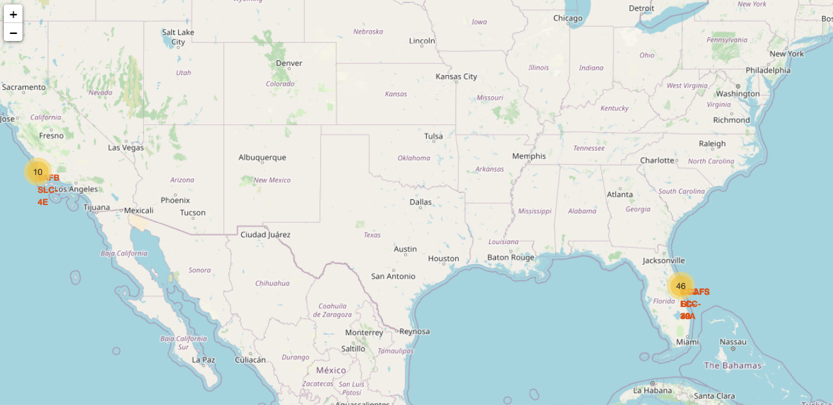
Launch sites analysis
We can see that all the SpaceX launch sites are located inside the United States
After you plot distance lines to the proximities, you can answer the following questions easily:
Are launch sites in close proximity to railways?
Are launch sites in close proximity to highways?
Are launch sites in close proximity to coastline?
Do launch sites keep certain distance away from cities?
Launch sites are in close proximity to highways, which allows for easily transport required people and property. Launch sites are in close proximity to railways, which allows transport for heavy cargo. Launch sites are not in close proximity to cities, which minimizes danger to population dense areas

Slide 25
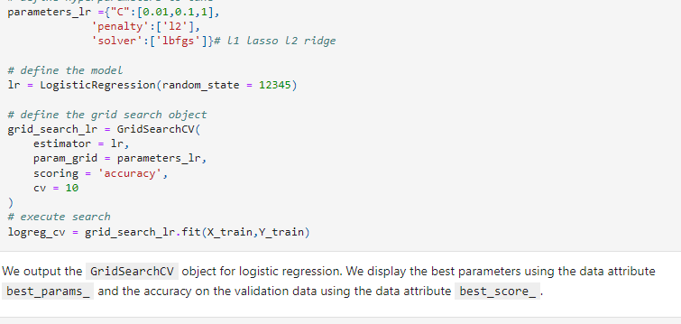
Predictive analysis
Classification Accuracy As we can see, by using the code as below: we could identify that the best algorithm to be the Tree Algorithm which have the highest classification accuracy

Slide 26
Ploty Dash
Built a ploty dashboard to play around with the data
Made plots in order to visualise it on a dashboard
Scatter plots and pie charts were made.

Slide 27
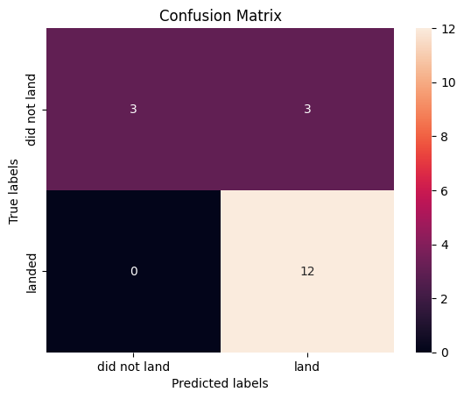
Confusion matrix
The confusion matrix for the decision tree classifier shows that the classifier can distinguish between the different classes. The major problem is the false positives .i.e., unsuccessful landing marked as successful landing by the classifier.

Slide 28
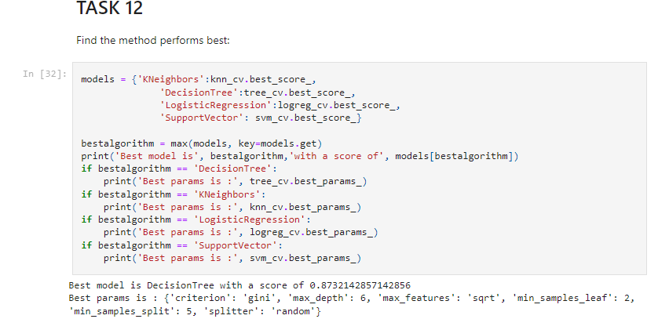
support vector machine, decision tree and k nearest neighbour
Performance Summary
A confusion matrix summarizes the performance of a classification algorithm
All the confusion matrices were identical
The fact that there are false positives (Type 1 error) is not good
Confusion Matrix Outputs:12 True positive
3 True negative
3 False positive
0 False Negative
Precision= TP / (TP + FP)12 / 15 = .80
Recall= TP / (TP + FN)12 / 12 = 1
F1 Score= 2 * (Precision * Recall) / (Precision + Recall)2 * (.8 * 1) / (.8 + 1) = .89
Accuracy= (TP + TN) / (TP + TN + FP + FN) = .833
Best method: decision tree

Slide 29

Conclusion
Research
Model Performance: The models performed similarly on the test set with the decision tree model slightly outperforming
Equator: Most of the launch sites are near the equator for an additional natural boost -due to the rotational speed of earth -whichhelps save the cost of putting in extra fuel and boosters
Coast: All the launch sites are close to the coast
Launch Success: Increases over time
KSC LC-39A: Has the highest success rate among launch sites. Has a 100% success rate for launches less than 5,500 kg
Orbits: ES-L1, GEO, HEO, and SSO have a 100% success rate
Payload Mass: Across all launch sites, the higher the payload mass (kg), the higher the success rate
Things to Consider
Dataset: A larger dataset will help build on the predictive analytics results to help understand if the findings can be generalizable to a larger data set
Feature Analysis / PCA: Additional feature analysis or principal component analysis should be conducted to see if it can help improve accuracy

